Slide 1

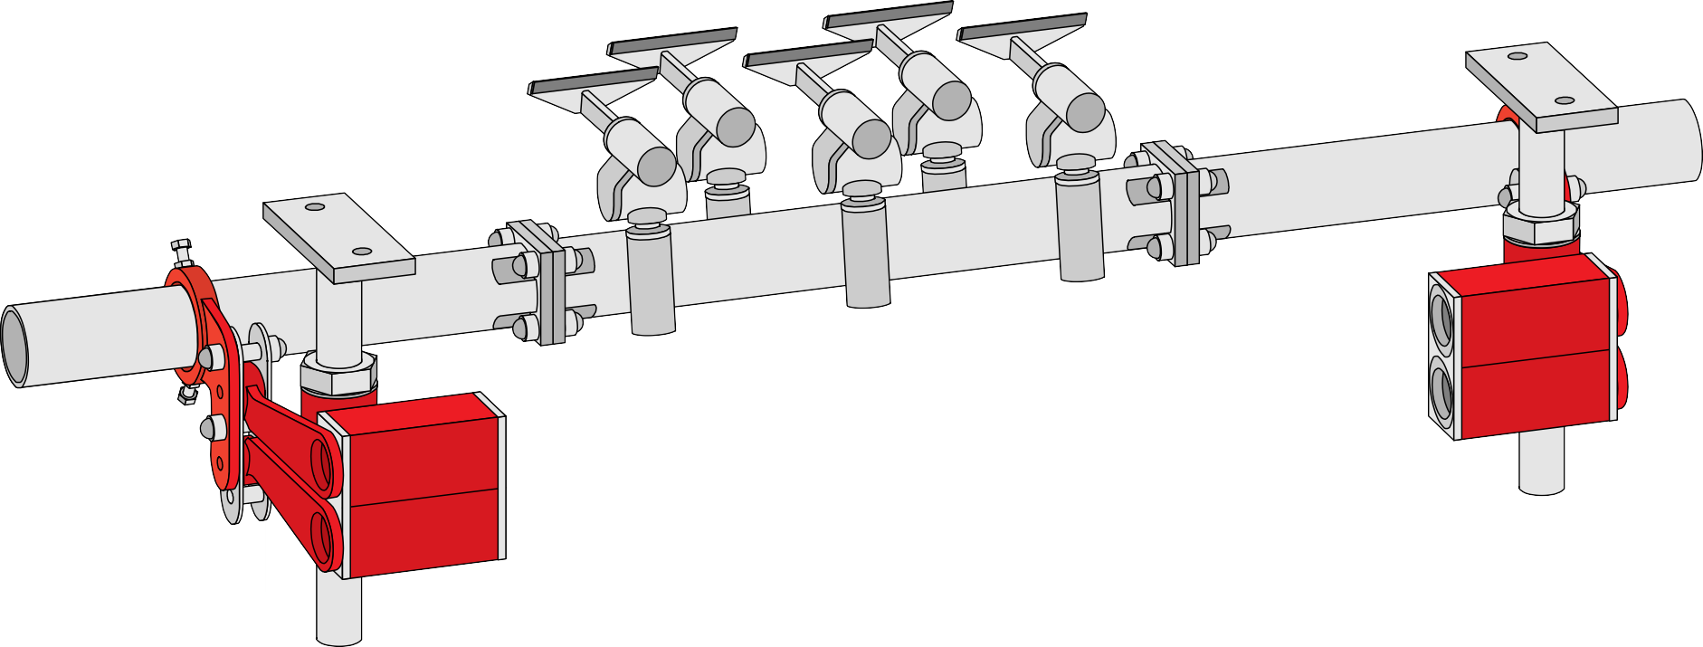
HOSCH Scraper Type CT Title
HOSCH Scraper Type CT
©1999 HOSCH
Basic Technical Training - 0360T - 19991029 - EN

Slide 2
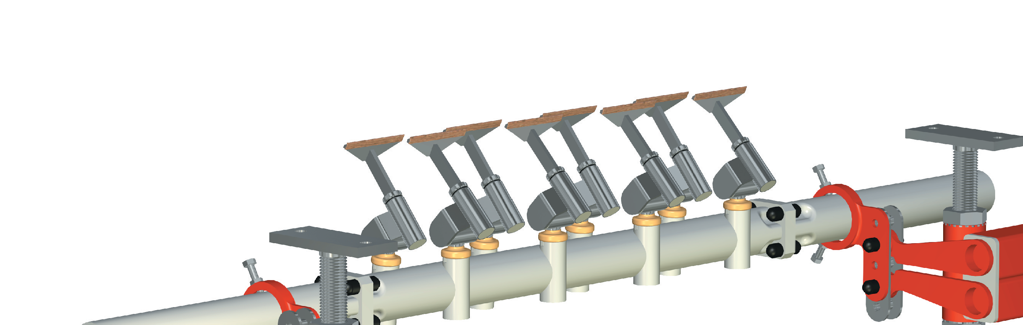

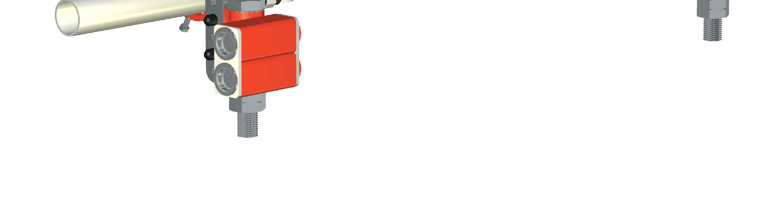
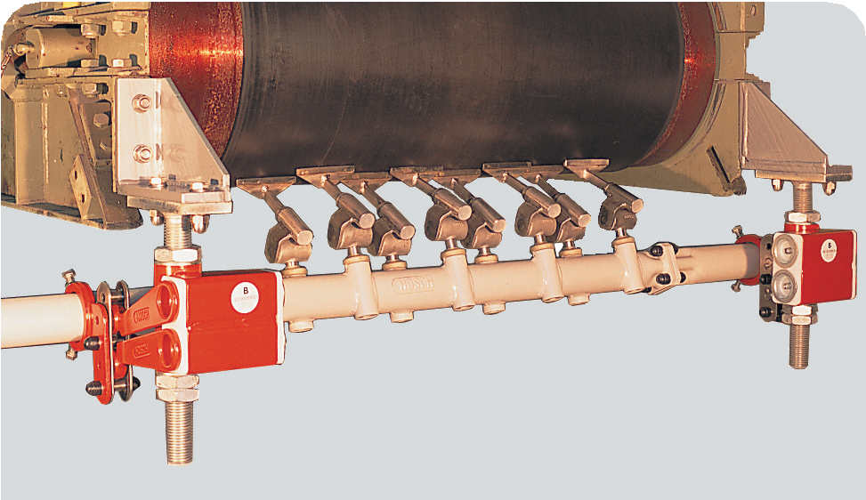

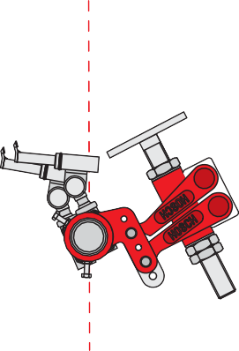


HOSCH
type CT SCRAPER
CT - Series
Double row main scraper
For medium to heavy duty belt applications For belt widths from 650 up to 2000 mm
For belt speeds up to 6 m/s Installed on the head pulley
©2002 HOSCH
Basic Technical Training - 0361T - 20020201 - EN

Slide 3
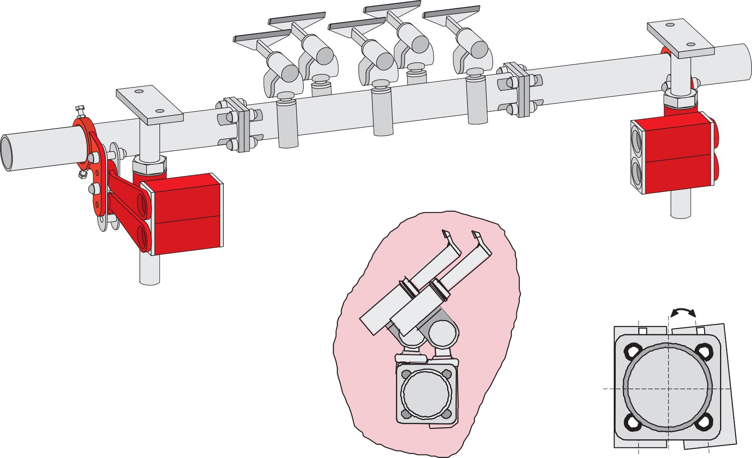
HOSCH Scraper Type CT
Characteristics of the assembly carrier
Position of the modules
5˚
Basic Technical Training - 0370T - 19991029 - EN

Slide 4


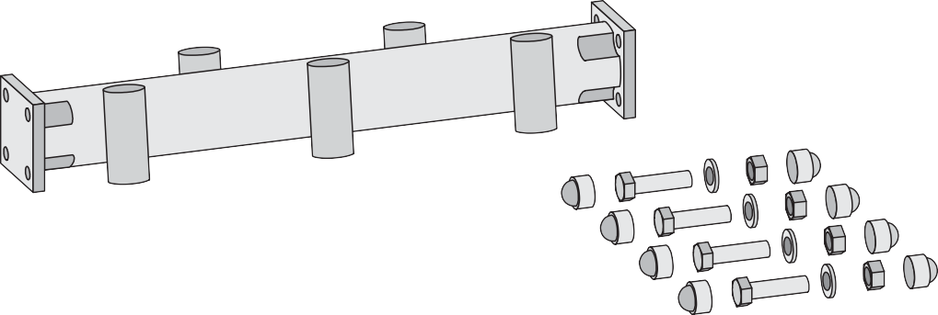
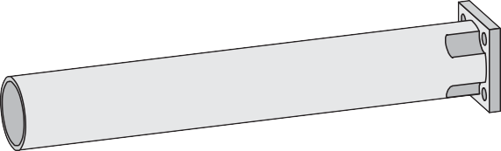
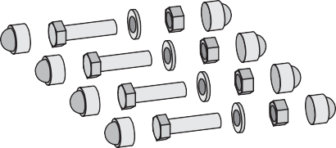
HOSCH Scraper Type CT Assembly Carrier
Assembly Carrier
Endsection
Midsection
Endsection
Basic Technical Training - 0380T - 19991029 - EN

Slide 5

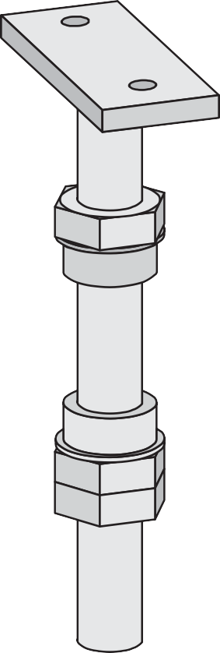

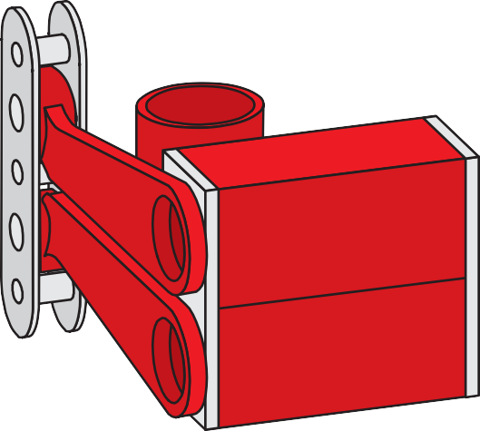
HOSCH Scraper Type CT Elastomount
Elastomount
Spindle
Elastomount
Locking ring
Basic Technical Training - 0390T - 19991029 - EN

Slide 6

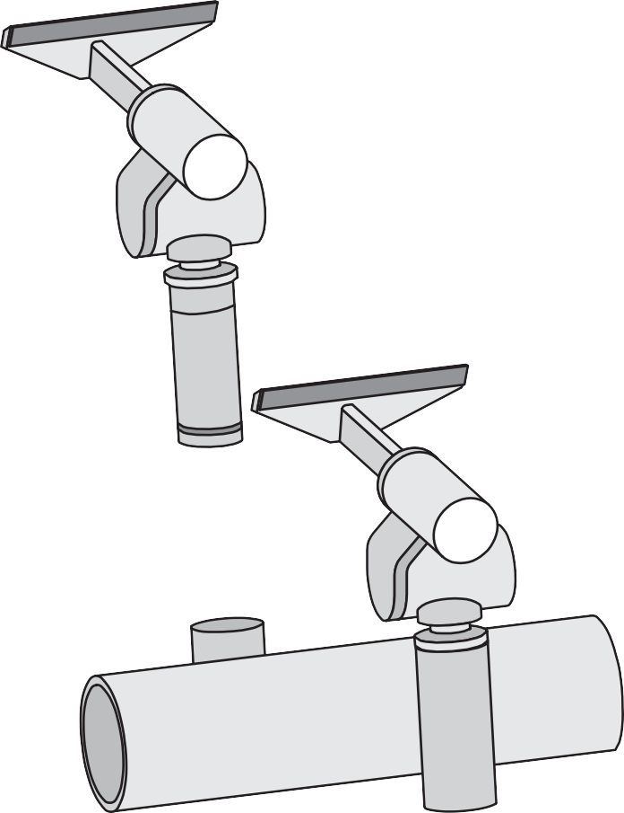
HOSCH Scraper Type CT Modules
Modules
Basic Technical Training - 0400T - 19991029 - EN

Slide 7

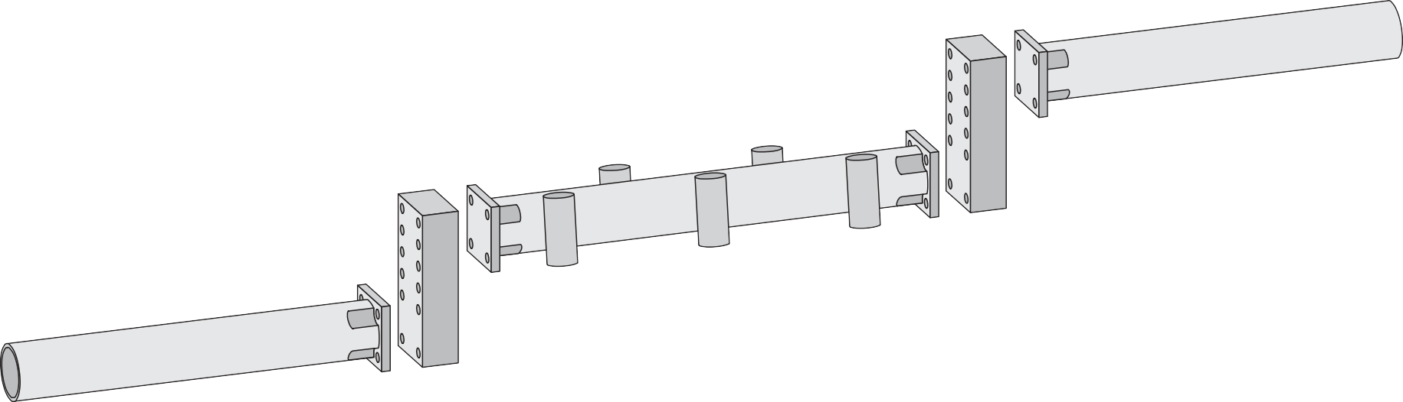
HOSCH Scraper Type CT Offset
Offset
Offset upwards
Offset downwards
Basic Technical Training - 0410T - 19991029 - EN

